Slide 1
Genome Sequencing Acceleration
EECS 570 Final Project Presentation
Apr. 12, 2023
Team: Al Dante
Po-Shao Chen, Fan Liu, Pei-En Li, Daniel Yu, Hsiang-Yang Fan, Hsin Ling Lu
Notes:
Hi, we are team Al Dante, today we are going to give a presentation about our final project topic, genome sequencing acceleration.

Slide 2
Outline
Introduction
Related Works
PairHMM
Intel Intrinsics Acceleration
CUDA Acceleration
Hardware Acceleration
Comparison
Summary and Conclusions
Work Distribution
Reference
Notes:
Here is the outline. First, we will give a brief introduction of genome sequencing and the related works. Next, we will talk about the algorithm we focus on in this group project. Then, introduction of different acceleration will be covered. After that, we will compare different acceleration and give the summary and conclusions about our work.

Slide 3
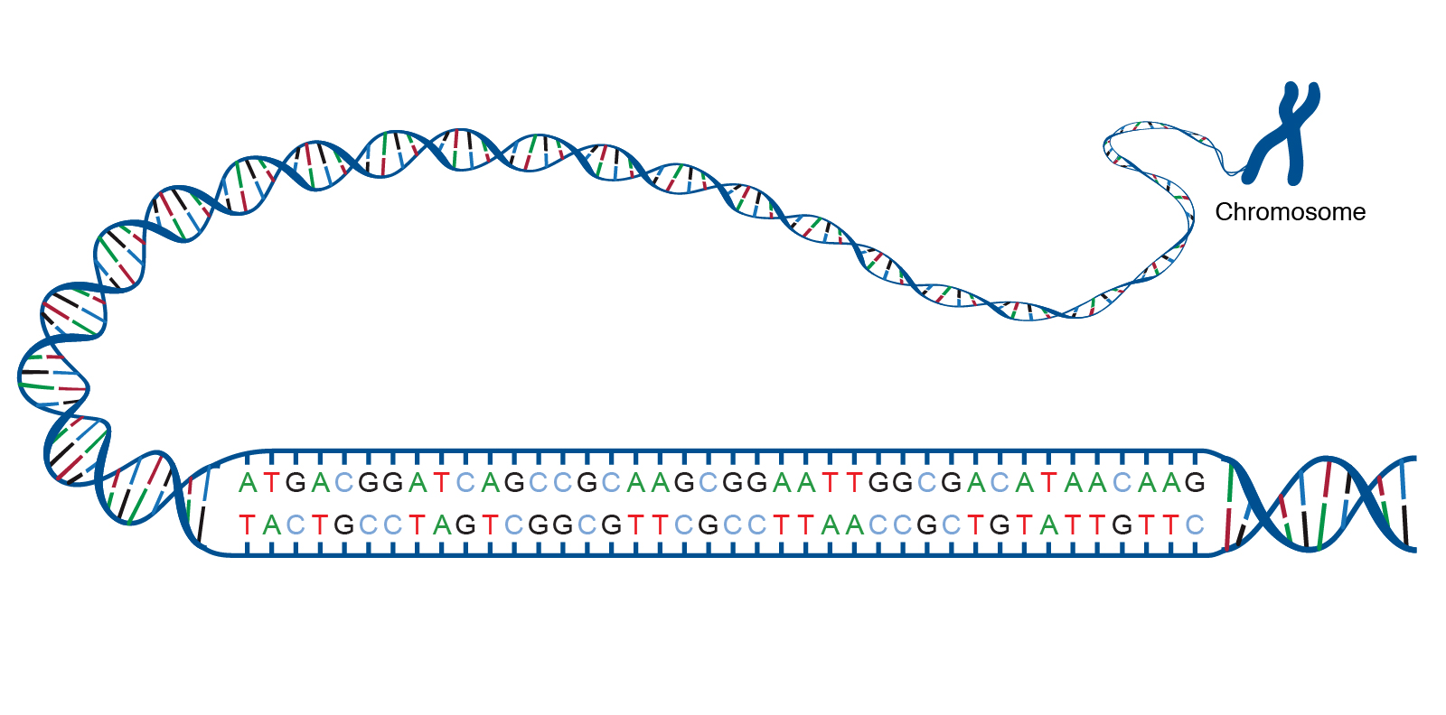
Introduction
A genome is a string consisting of 4 different DNA bases (A, T, C, and G)
DNA is a critical information for all living creatures
Identify the genetic structure of or organism
Source: https://www.genome.gov/genetics-glossary/acgt
Notes:
Here is a figure of a chromosome and its DNA. If we could pull the coiled string in a chromosome straight, we could see there are tons of DNA bases in this string. A genome includes 4 different kinds of DNA bases, which are A, T, C, and G. From DNA data, we could differentiate different species and determine how strong the proximity is between species. Within the same species, different genome sequence could disclose some underlying information, such as vulnerability to a disease or identification of a slight mutation.

Slide 4

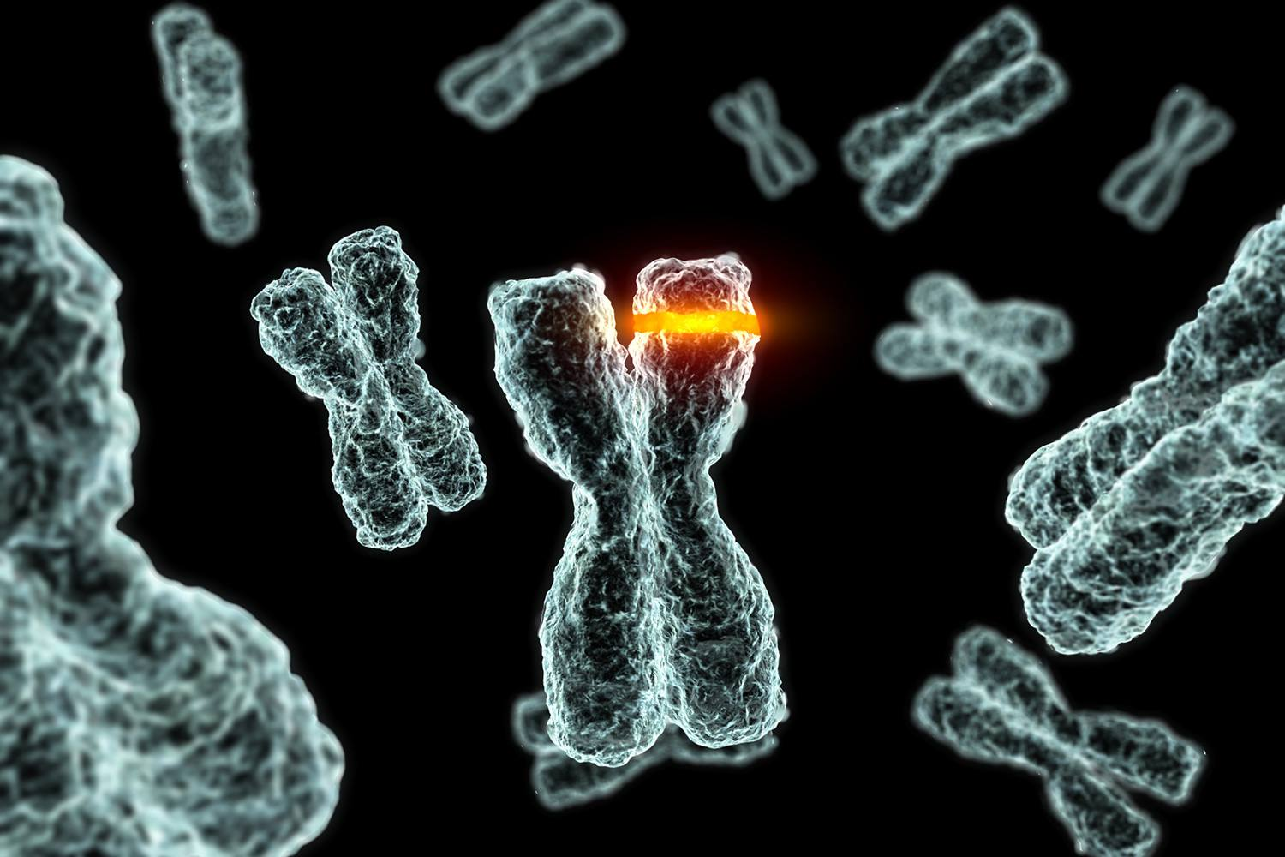

Applications
Genetic Diseases Anticipation
Precision Medicine
Genetic Counseling
Notes:
Let’s talk about the applications of genome sequencing. They includes precision medicine, genetic diseases anticipation, and genetic counseling.
By observing different genome sequences from people, doctors could identify a specific DNA segment may cause defects in human bodies, such as toxic ingredients of a medicine could not be excreted. With the information, doctors can precisely customize the treatments of different patients to enhance the efficiency of treatments.
DNA sequencing can help people to make sure whether they will have a diseases by checking they have the same gene mutation as previous patients. People could take some precautions to decrease or remove the impact of the diseases in the future.
For the couples who would like to have children, genetic counseling could be benefitted from genome sequencing by enhancing the efficiency of listing any kind of genetic diseases their child might have.

Slide 5
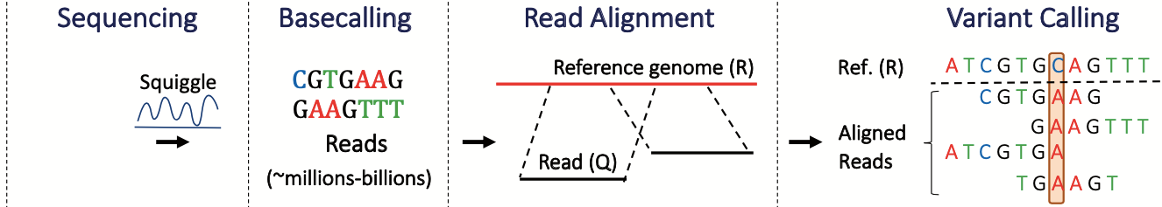
Genome Sequencing Flow [1]
Read alignment and variant calling are main time-consuming steps
Notes:
Here is the flow of genome sequencing. First, in sequencing step, a sequencer reads the DNA from biological samples and generates raw signals based on what it reads. Next, basecalling interprets these raw signals into DNA bases {A, T, C, G}. After that, read alignment find the best location for each read in the reference genome. At last, variant calling applies machine learning-based or statistics-based methods to deal with variants from aligned reads.
Among these steps, read alignment and variant calling are the main time-consuming steps. In our project (click), we chose read alignment for our acceleration target.

Slide 6
Related Works
Smith-Waterman FPGA acceleration [2][3]
Co-processor with modified Smith-Waterman [4]
Burrows-Wheeler transform hardware accelerator [5]
Notes:
Chen et al. and Chen et al. propose architectures for Smith-Waterman algorithm acceleration with FPGA implementation. Turakhia et. al. implements a co-processor with modified Smith-Waterman algorithm and D-SOFT(Diagonal-band Seed Overlapping based Filtration Technique) seeding algorithm for reducing the search space of read alignment. Apart from Smith-Waterman algorithm, Fernandez et al. proposes a hardware accelerator for the read alignment algorithm based on Burrows-Wheeler transform, an algorithm used to prepare data for use with data compression techniques. (such as bzip2)

Slide 7
Outline
Introduction
Related Works
PairHMM
Intel Intrinsics Acceleration
CUDA Acceleration
Hardware Acceleration
Comparison
Summary and Conclusions
Work Distribution
Reference
Notes:
Then, let’s talk about the algorithm we would like accelerate.

Slide 8
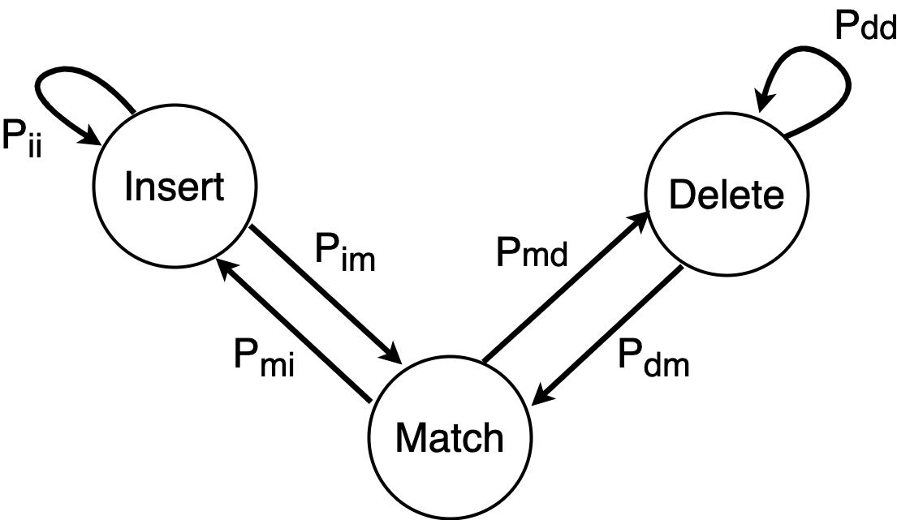
PairHMM Algorithm [5]
Finding the path with highest score
Products of probability are accumulated
Compute-intensive dynamic programming
Maximum matching score of each read is kept to decide the optimal read length
Seq X | T | A | G | C | A | -
Seq Y | - | - | G | C | A | T
Hidden state sequence | I | I | M | M | M | D
Notes:
Here are two sequences. Dashes (-) means no symbol in that sequence. There are three states in the algorithm, insert, delete, and match. When transition from a state to the other state, the score is multiplied by a probability value that corresponds to the current transition, which are Pii, Pim, Pmi, Pmd, Pdm, and Pdd. Our goal here is to find a sequence of states that has largest value. PairHMM algorithm could be handled by dynamic programming, which is compute-intensive. Since the full length of a read may not have the highest scores compare to partial length of a read, maximum matching score of each read is recorded during executing dynamic programming.
Let me pass the baton to my teammates

Slide 9
Outline
Introduction
Related Works
PairHMM
Intel Intrinsics Acceleration
CUDA Acceleration
Hardware Acceleration
Comparison
Summary and Conclusions
Work Distribution
Reference

Slide 10
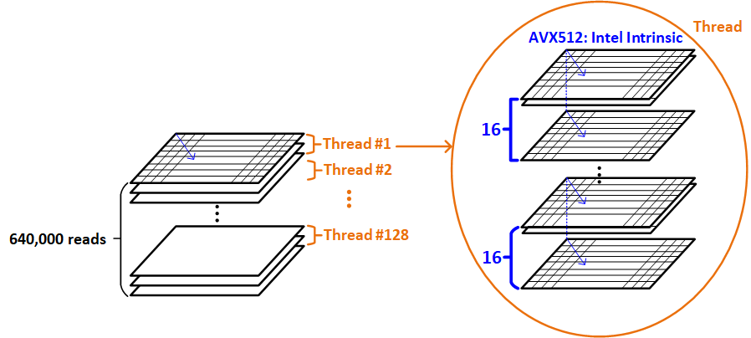
Intel Intrinsics
No dependency between each data
Segmentation Fault
Flatten 2D array into 1D: access with 1D index
Use scatter and gather function to access large noncontiguous memory
Notes:
For thread acceleration, we divide the the total number of data by the number of threads. And for each thread, we further accelerate with Intel Intrinsic.
We know that the computation of each data is independent of each other, therefore we can load, compute and get 16 results at a time with SIMD vector.
We encounter segmentation fault and we try to solve it with 1 & 2

Slide 11
Outline
Introduction
Related Works
PairHMM
Intel Intrinsics Acceleration
CUDA Acceleration
Hardware Acceleration
Comparison
Summary and Conclusions
Work Distribution
Reference
Notes:
Now we are going to talk about our CUDA acceleration.

Slide 12

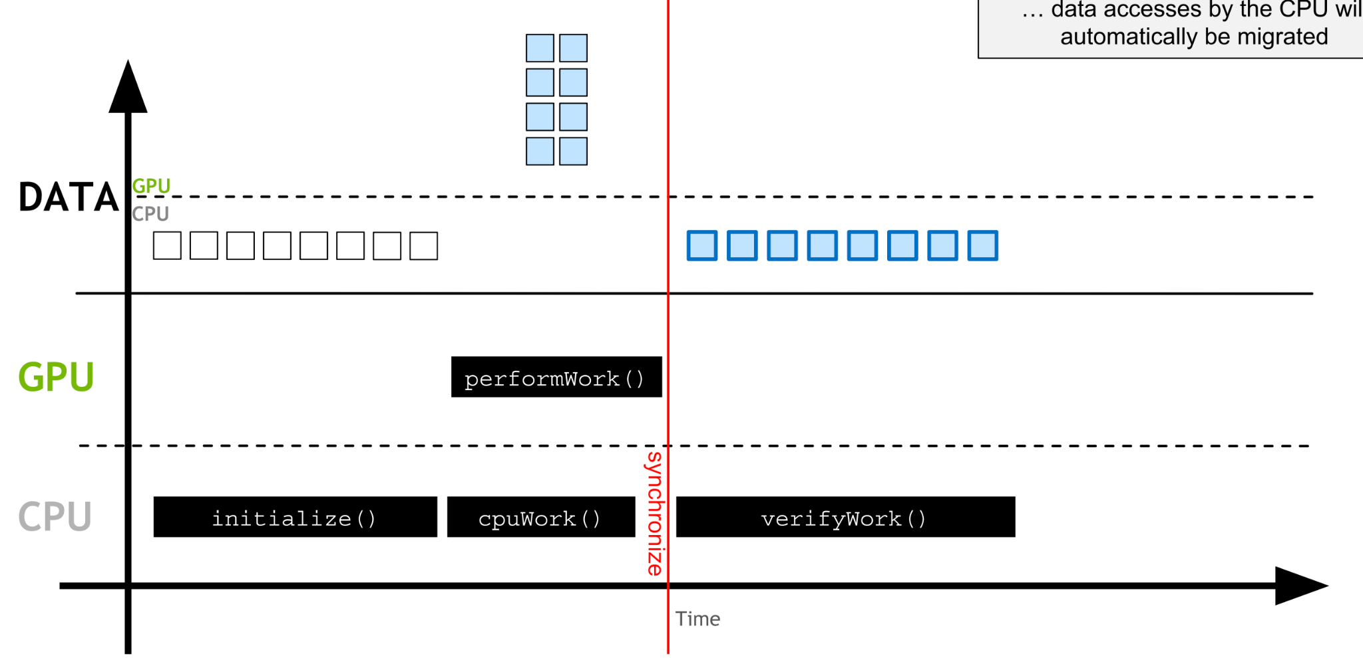
CUDA
Notes:
So this is how we transfer the data from CPU to GPU. First, we initialize the data in CPU. Through a GPU kernel, the data will automatically migrated to the GPU to do all the parallel work. Since work on GPU is asynchronous, we have to synchronize it by a cuda function called cudaDeviceSynchronize(). After that, the data accesses by CPU will automatically be migrated.

Slide 13
CUDA Instruction
int main(void) { //Host Code
//Do sequential stuff
//Allocate memory on the device
cudaMalloc(...);
//Copy data from Host to Device
cudaMemcpy(...);
//Launch Kernel
kernel<<<grid_size, block_size>>>(...);
//Copy data from Device to Host
cudaMemcpy(...);
// …
cudaFree(...);
return 0;
__global__ void kernel (...) {
//gpu operation
}

Slide 14
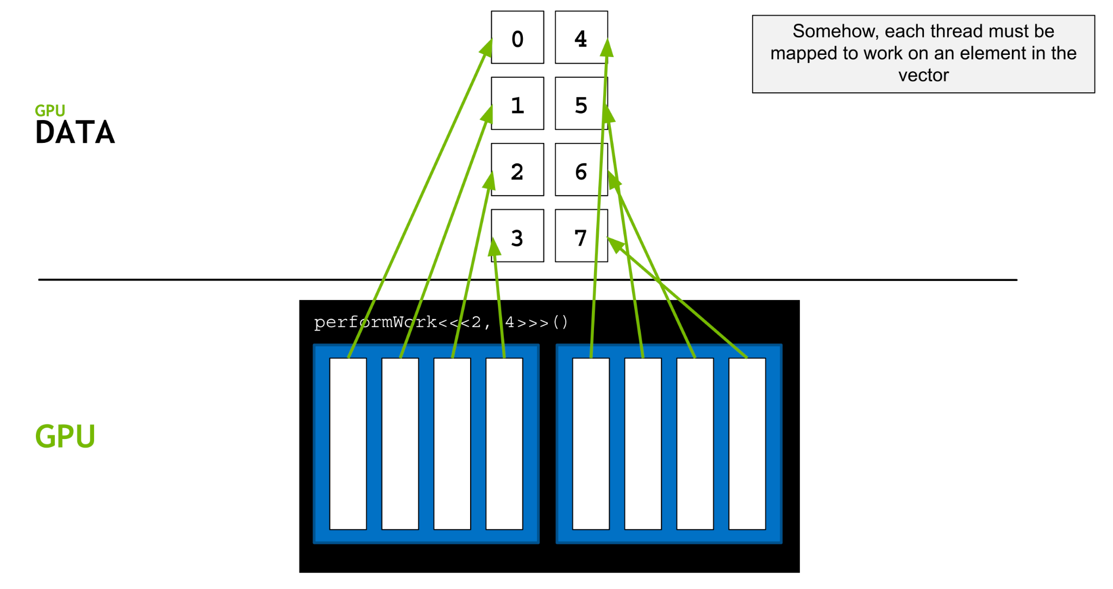
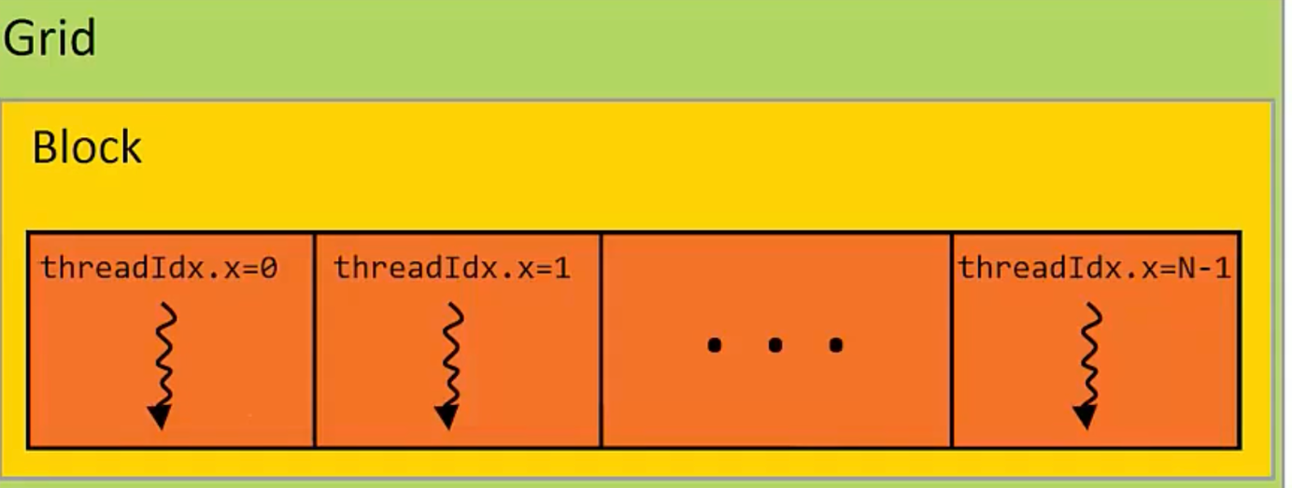
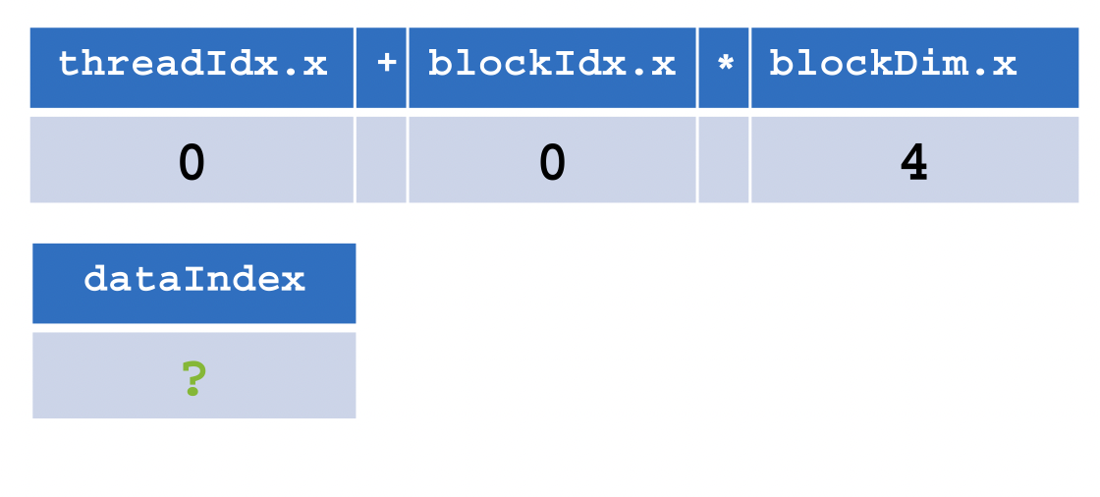
CUDA

Slide 15
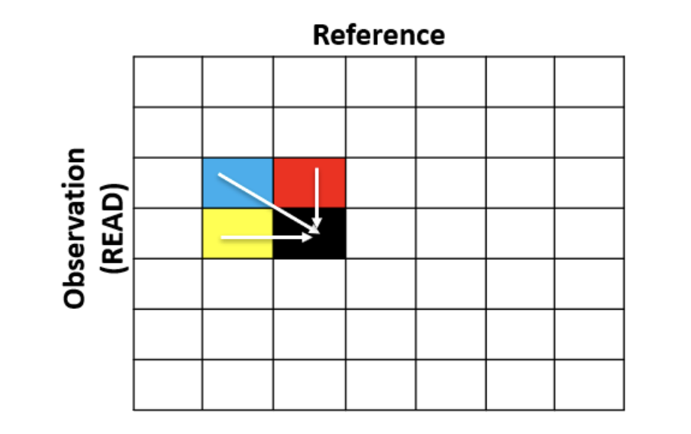
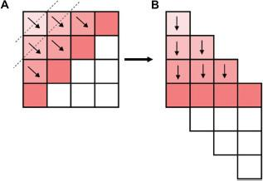
CUDA: Wavefront Alignment
Notes:
As the pair HMM algorithm we mentioned before, when we’re calculating the current i,j data in the array. We need to base on the previous i,j data as the left hand figure shows. That means the data has dependencies so that we cannot just put the whole array into cuda to do the acceleration. So we decide to use the wavefront alignment as the right hand figure shows. We cut the array align the diag like A and send the data on the same dotted line in to cuda to do data parallelism. So we can reconstruct the origin array as the part B shows.

Slide 16
CUDA: Wavefront Alignment
Baseline: 1501590645 us
Acceleration time: 492469653 us
Speedup ~3.27x faster
Why?
Data dependency, not much data parallelism instruction in this part of code
Too many memory copy between Host and Device when implementing Wavefront Alignment
Notes:
This is the result of our cuda wavefront alignment. Our speedup is about 3.27x faster. The speedup does not seem like very much. We analyze the reason is

Slide 17
CUDA: Inter-Read Vectorization
Dependencies in one read - Inefficiency in vectorized
Map Multiple Reads onto GPU (Grids, Blocks, Threads)
Grid
Block
Block
Block
Block
Read Region
Read
haplotype

Slide 18
CUDA: Inter-Read Vectorization
Interleave different reads - mapping to threads/blocks
Ex: blockDim = 2, gridDim = 3
Grid
index = blockIdx.x * blockDim.x + threadIdx.x;
stride = blockDim.x * gridDim.x;
A
T
C
G
A
T
C
G
C
G
A
T
C
G
A
T
Block0
Block1
Block2
G
C
T
A
G
C
T
A
G
T
A
C
T
A
T
A
G
C
T
A
G
C
C
A
T
G
A
C
G
C
A
T
G
C
A
T
T
C
C
A
T
C
C
A
T
G
C
A
C
C
A
C
G
T
G
T
Notes:
Interleave multiple reads into another array, and send to GPU. take blockDim = 2, gridDim = 3 as ex. On GPU my idx would be …., means do stride at same time.

Slide 19
CUDA: Inter-Read Vectorization
Grid
index = blockIdx.x * blockDim.x + threadIdx.x;
stride = blockDim.x * gridDim.x;
Block0
Block1
Block1
G
T
A
C
T
A
Serial
C
A
T
G
A
C
T
G
C
A
C
C
A
C
G
T
G
T
Parallel

Slide 20
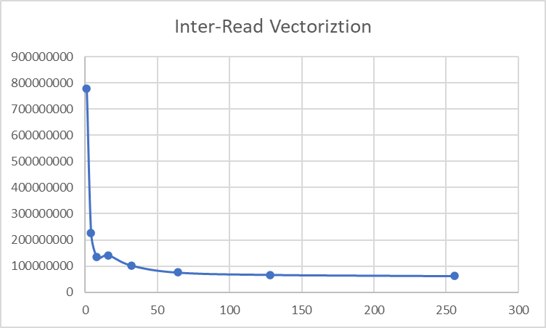
CUDA: Inter-Read Vectorization
Baseline: 136378698 us
Blocknum=1: 778114186 us
Saturated time: ~60000000 us
Only ~2x faster
Too many memory allocation
( 4 tables for each thread)
4 If-else block in kernel function, hurt GPU
Notes:
First, implement baseline code on machine. redo data structure. limited acceleration is caused by

Slide 21
Outline
Introduction
Related Works
PairHMM
Intel Intrinsics Acceleration
CUDA Acceleration
Hardware Acceleration
Comparison
Summary and Conclusions
Work Distribution
Reference

Slide 22
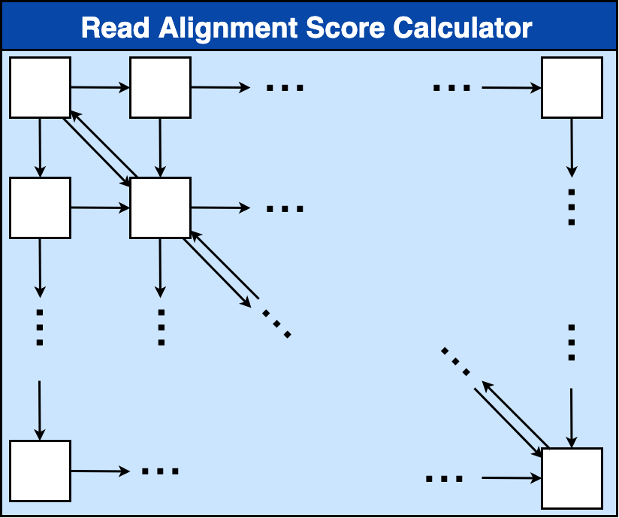
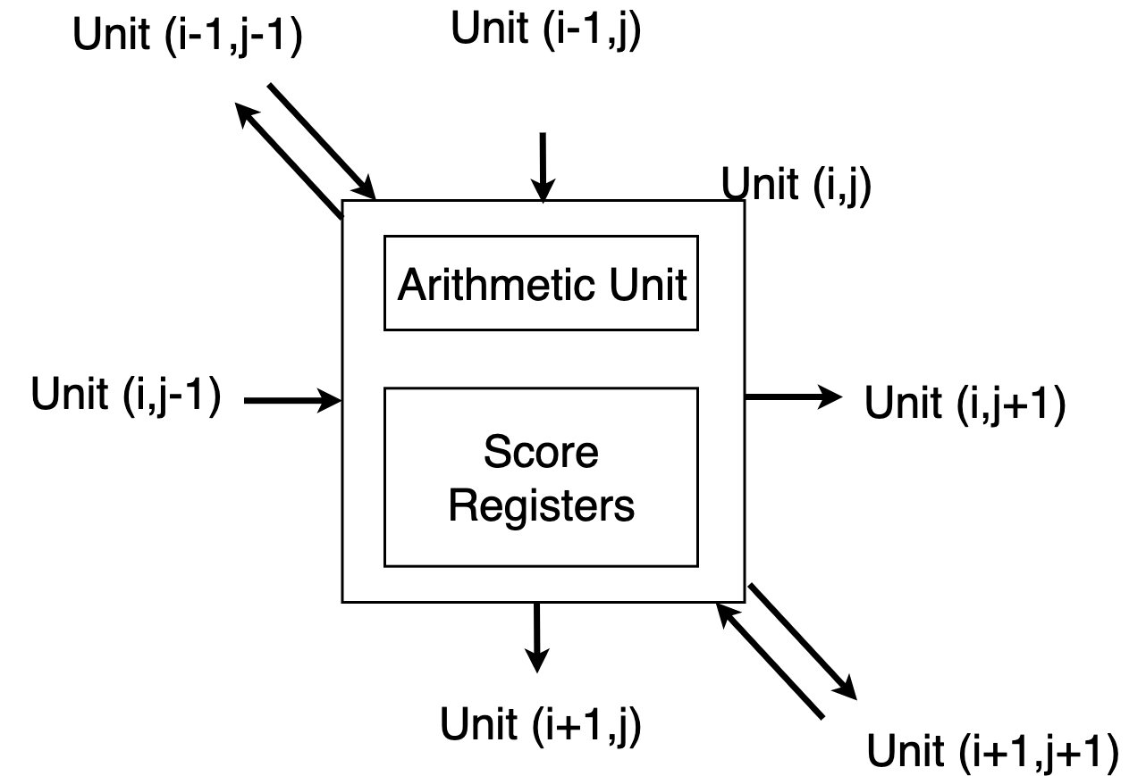
Hardware Accelerator
Systolic array
Logarithmic addition replaces multiplication -> reducing computation complexity
Each unit: 52415 um^2 (Synthesized @133 MHz)
Notes:
Accelerate the dynamic programming. reduce data allocation complexity. Logarithmic addition over the multiplication. nomarlized addition into 19 bits. handshake signals to make sure the core get valid value

Slide 23
Walkthrough
Propagate to the bottom right corner
Notes:
The 1st cycle top left compute. we can do calculations in 1 cycle. memory allocation is simple. wavefront pattern is pretty good for our max select.

Slide 24
Max Select
Find the maximum scores
Scores in same row arrive at different cycles
Do one comparison in a cycle
Comparison
Notes:
pass larger value to right, get max value

Slide 25
Comparison
640000 short reads from SRA: SRR7733443, 1 long read
Environment of baseline and pthread: Intel(R) Xeon(R) CPU E5-2630 v3 @ 2.40GHz
5.18 us per read (hardware) => 3315200 us
 | Runtime (us) | Acceleration
Baseline | 1501590645 | 1x
Pthread | 101137734 | 14.85x
CUDA (WFA) | 492469653 | 3.27x
CUDA (IRV) | 683646923 | 2.20x
Hardware | 3315200 | 452x

Slide 26
Summary and Conclusions
Software has limited impact on dynamic programming
Hardware acceleration have to consider other issues(area, power)
Currently 500KB used in PE array
Area can be reduced by pipelining read segments

Slide 27
Work Distribution
Po-Shao Chen: baseline code, Intel Intrinsics (debug), hardware accelerator
Fan Liu: CUDA (Inter-Read Vectorization), hardware accelerator
Pei-En Li: Intel Intrinsics (apply vectorization functions, debug)
Daniel Yu: CUDA (Wavefront Alignment accelerator, debug)
Hsiang-Yang Fan: CUDA (workstation setup, script writing, debug)
Hsin Ling Lu: CUDA (Wavefront Alignment accelerator, debug)

Slide 28
Reference
[1] A. Subramaniyan, Y. Gu, T. Dunn, S. Paul, M. Vasimuddin, S. R. Das, “Genomicsbench: A benchmark suite for Genomics,” 2021 IEEE International Symposium on Performance Analysis of Systems and Software (ISPASS), 2021.
[2] Y.-T. Chen, J. Cong, J. Lei, and P. Wei, “A novel high-throughput acceleration engine for read alignment,” 2015 IEEE 23rd Annual International Symposium on Field-Programmable Custom Computing Machines, 2015.
[3] Y.-L. Chen, B.-Y. Chang, C.-H. Yang, and T.-D. Chiueh (2021). A high-throughput FPGA accelerator for short-read mapping of the whole human genome. IEEE Transactions on Parallel and Distributed Systems, 32(6), 1465–1478.
[4] Y. Turakhia, G. Bejerano, and W. J. Dally, “Darwin: A Genomics coprocessor,” IEEE Micro, vol. 39, no. 3, pp. 29–37, 2019.
[5] E. B. Fernandez, W. A. Najjar, S. Lonardi, and J. Villarreal, “Multithreaded FPGA acceleration of DNA sequence mapping,” 2012 IEEE Conference on High Performance Extreme Computing, 2012.
[6] Richard Durbin, Sean R Eddy, Anders Krogh, and Graeme Mitchison. Biological sequence analysis: probabilistic models of proteins and nucleic acids. Cambridge university press, 1998.
[7] NVIDIA, www.nvidia.com

